Slide 1
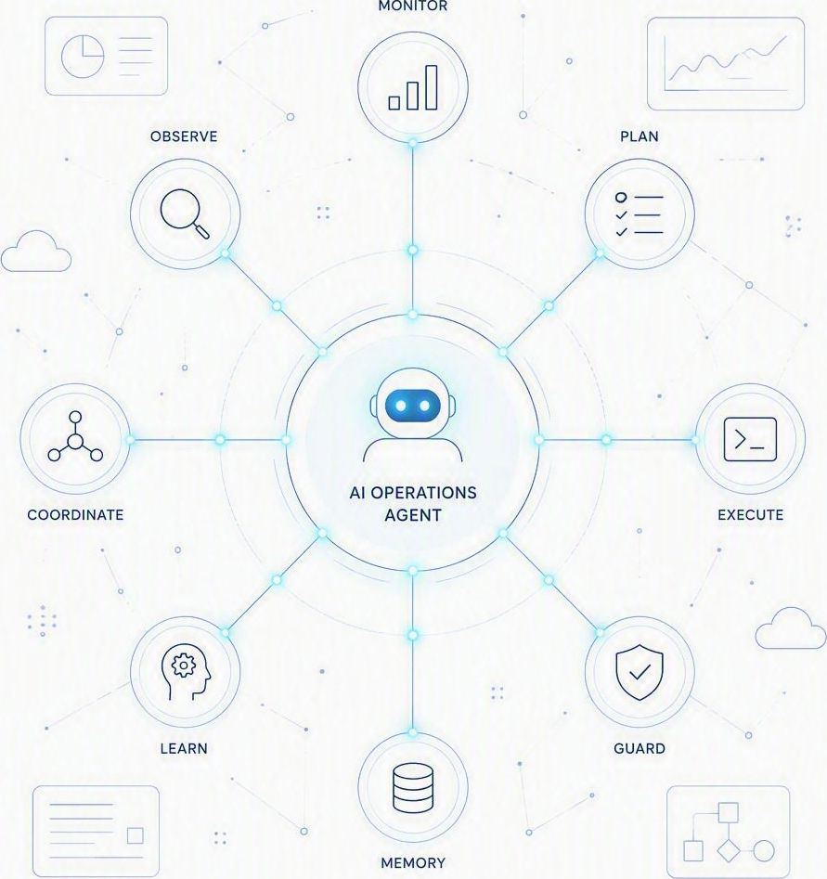
AGENTIC AI | OPERATIONS
OpsAgent
Agentic AI in a real operational use case — an autonomous agent that watches, decides and acts across day-to-day operations, with people in control.
Architecture
End-to-end workflow
Technical stack
Executive briefing

Slide 2


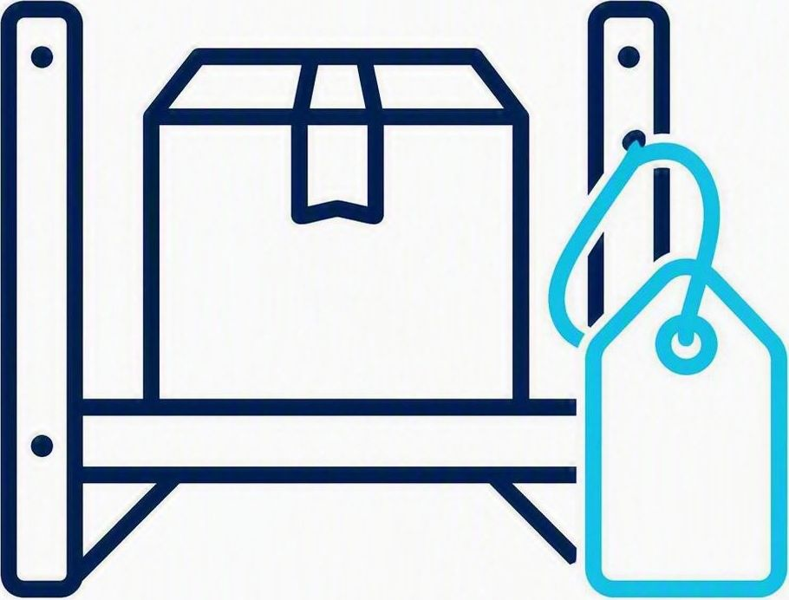



HOW IT IS BUILT
OpsAgent architecture
One orchestrating agent plans the work and calls each specialised sub-agent on demand — not in a fixed sequence.
MAIN ORCHESTRATING AGENT
Plans the work and calls the sub-agents it needs
Extraction Agent
Inventory & Pricing Agent
Governance & Request Agent
Document Generation Agent
Communication Agent
INPUT
INPUT
INPUT
INPUT
INPUT
Customer's raw email
Structured order data
Draft inquiry or pricing
Approved pricing
Quotation or unavailability result
OUTPUT
OUTPUT
OUTPUT
OUTPUT
OUTPUT
Structured data: items, quantities, dates, durations
Facility availability and base pricing from Dataverse
Human review and approval decision
Official quotation document
Draft email for Sales to review and send
OpsAgent — Agentic AI in a real use case
2

Slide 3
HOW IT RUNS
End-to-end operational workflow
From the customer's inquiry email to a sent quotation — with Sales approving at every gate.
PHASE 1
PHASE 2
PHASE 3
PHASE 4
PHASE 5
Ingestion & Extraction
Availability & Base Pricing
Sales Pricing Review
Finance Approval
Quotation & Dispatch
Customer emails the Sales shared inbox
OpsAgent calls the Extraction Agent
Items, dates and quantities extracted
Database checked for facility availability
Base pricing generated for available items
Pricing Review Request sent to Sales
Salesperson accepts or adjusts pricing
Submits it for financial approval
Proposal routed to the Finance approver
Finance approves, rejects or requests changes
Quotation document generated
Draft email with attachment prepared
Salesperson reviews and sends it
IF ITEMS ARE UNAVAILABLE
IF FINANCE REJECTS OR REQUESTS CHANGES
OpsAgent sends a Review Order Inquiry to the Salesperson, who either edits the requested items — returning the flow to Phase 2 for a fresh check — or has OpsAgent draft an Unavailability Email to review and send, which ends the workflow.
The proposal routes straight back to Phase 3 so the Salesperson can adjust the pricing and resubmit it for approval.
OpsAgent — Agentic AI in a real use case
3

Slide 4
WHAT IT RUNS ON
High-level technical stack
A Microsoft-native stack: Copilot Studio orchestrates, Azure AI reasons, and Teams, Outlook and Dataverse carry the work.
Microsoft Copilot Studio
Runs the end-to-end workflow with multi-agent routing (Generative Actions), delegating tasks to the specialised sub-agents and bridging the front-end apps with back-end AI models and data.
ORCHESTRATION ENGINE
Azure AI Foundry
Supplies the enterprise-grade large language models that let the Extraction Agent pull structured details out of unstructured customer emails.
AI MODEL LIBRARY
Microsoft Teams
Adaptive Cards present the information and capture every Sales review and Finance approval, without pushing users into a separate web portal.
HUMAN-IN-THE-LOOP INTERFACE
Microsoft Outlook
Captures inbound customer inquiries through the generic Sales inbox and stages pre-formatted outbound drafts for a final human review.
COMMUNICATION HUB
Microsoft Dataverse
Holds live facility availability and inventory, and enforces corporate pricing rules whenever a quotation is priced.
SECURE DATA BACKEND
Every component is standard Microsoft 365 or Azure — no new portal for the Sales team to learn.
OpsAgent — Agentic AI in a real use case
4

